Slide 1

AI-Powered Data Quality Enhancer: HCSIT04
Unleash the full potential of your AI/ML models with DataDome, the AI-powered data quality enhancer. Improve model accuracy and reduce preprocessing time.
by CKB: -
Nishantak Panigrahi
Prem Savla
Mayank Singh Patwal
Punya Jain
Maitree Patel
N

Slide 2

The Data Quality Crisis: Why Your Models Are Suffering
Outliers
Datatype Inconsistencies
Duplicates
Missing Values
Redundant data increases storage, computational time and skews analysis.
Incomplete data introduces bias and inaccurate predictions.
Extreme values distort statistical analysis, underfitting models.
Incorrect data types create processing bottlenecks, and errors

Slide 3





How DataDome Works: AI-Driven Detection & Correction
Data Profiling
Comprehensive data assessment.
Anomaly Detection
Identify schema inconsistencies and outliers.
Intelligent Correction
Automated data refinement.
Diversification
Ensure data diversity by extending datasets.

Slide 4



Duplicate Detection and Removal
MD5 Hashing
Generates unique fingerprints for each row.
Time Efficiency
Reduces storage requirements and processing time.
Data Integrity
Removal of exact duplicates, even those with different formatting
or difference whitespaces.

Slide 5
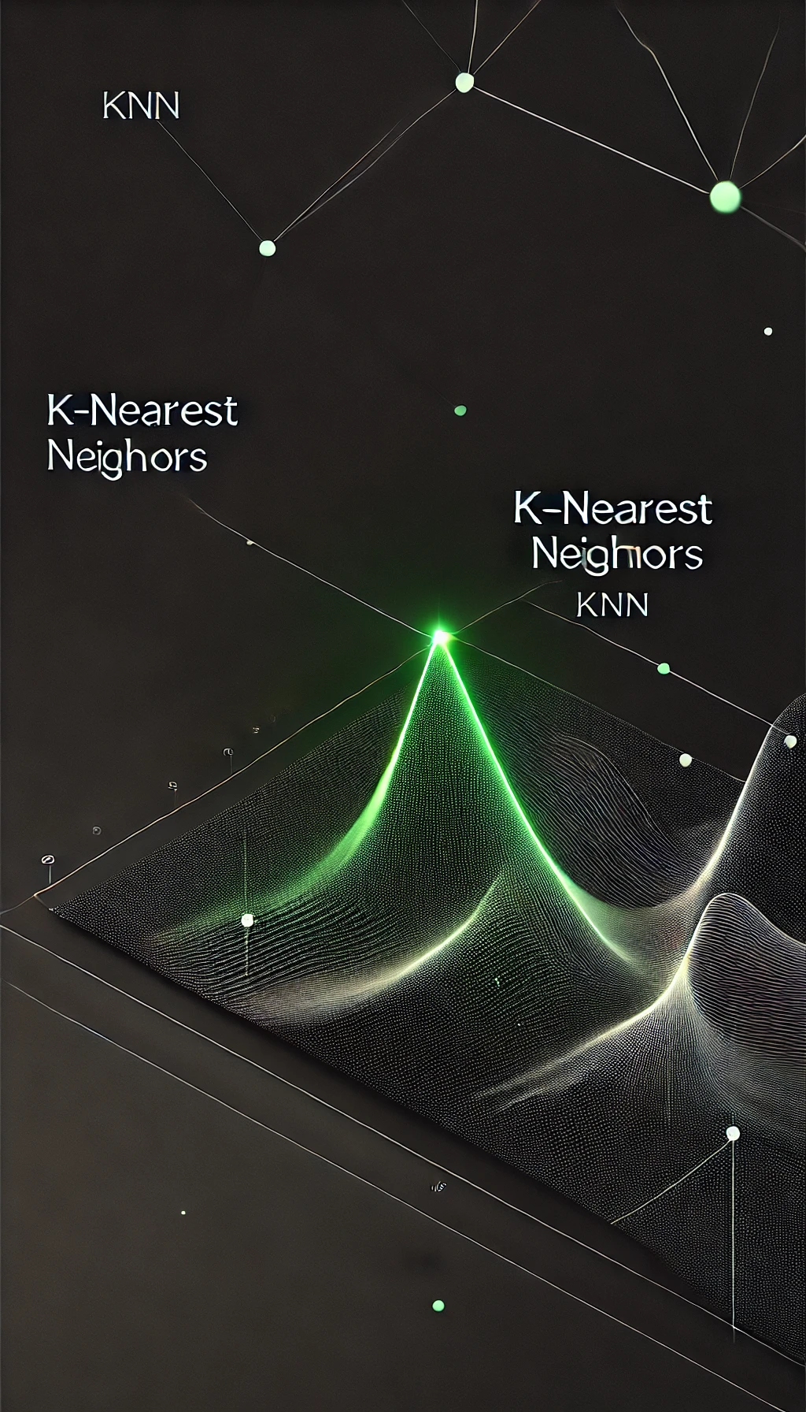



Handling Missing Values
KNN Imputation
Mode Imputation
Skewness Analysis
Infers numerical missing data based on nearest neighbors to provide a social network type validation to the filled value
For small missing values (below 5%) applies mean/median imputation based on data skew.
Imputes categorical missing values with the mode.

Slide 6



Outlier Detection and Removal
Enhances model generalization by preventing outliers from distorting predictions.
DBSCAN
2
Detects and removes outliers in the PCA-
reduced data, ensuring that only genuine
anomalies are removed.
PCA
1
highlight the most important variance in
the dataset
Data Preservation
Removes outliers without sacrificing data.
3

Slide 7
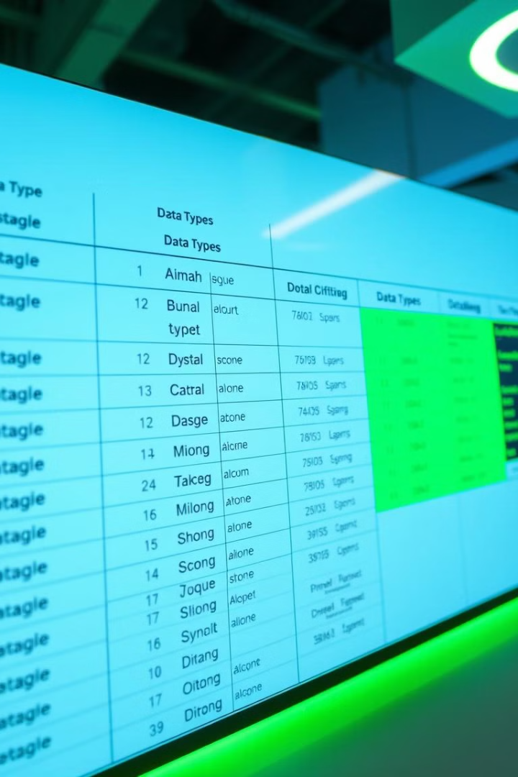
Datatype Validation and Normalization
1
Automatic Inference
2
Consistency in Formats
Ensures proper column typing, recognizing categorical and numeric types and parsing datetime fields correctly
Ensures uniform dates and sanitizes
numerics.
2
Automated Transforms
Automatically applies data transforms like One Hot Encoding, Scaling to
save time and efforts

Slide 8
Additional Innovations (In Progress)
CTGAN to improve data diversity, scarcity,
model generalization
1
Generate realistic synthetic data to diversify the dataset
while maintaining global structure and avoiding excessive local patterns.
2
CNN for Image Dataset
Improve image dataset handling by automating preprocessing
steps such as resizing, scaling, and augmentation
3
NLP for more contextually aware dataset
Handle textual columns
Identify outliers or rule-based constraints based on column names

Slide 9
Why This is the Best Solution
Optimal Algorithms
1
Efficient, minimizes overhead.
Comprehensive Cleaning
2
Covers all aspects of data quality.
Generalized and Scalable
3
Allows non-experts to access clean datasets quickly and easily
balancing both convenience and accuracy

Slide 10

DataDome vs. Traditional Methods: Speed & Accuracy
Feature
DataDome
Traditional Methods
Speed
Automated, fast
Manual, time-consuming
Accuracy
AI-driven, high precision
Human error, bias
Scalability
Scalable
Limited

Slide 11

Addressing the SDGs
SDG 9
Smart Infrastructure
Promotes efficient data infrastructure for industries, reducing computational resources and building a sustainable future
Industry, Innovation, and Infrastructure.
AI for Data Quality
high-quality datasets empower industries to innovate faster and
more effectively using resilient, future-proof data systems

